Slide 1


Course Registration System APPLICATION
(using Core JAVA, Rest, Angular & SQL)
TEAM G1 MEMBERS -
ASHOK PATHIPATI
ABHISHEK CHATURE
MEKALA GIRIDHAR REDDY
MADHUCHANDAN
KOSURI RAJESH

Slide 2

Framework for 6 Weeks
Entire 6 weeks plan (10th May 2022 – 20th June 2022)
- Introduction of the Project and required Tools.
Discussion of required topic and practical execution of some examples.
- every morning session started with List of Tasks to be performed.
- Every session ends with a code review and doubt clearance.

Slide 3
TOPICS 1. Topics discussed 2.project goals 3.technologies used 4.development 5.technical challenges 6.demonstration 7.PROJECT LINK
Notes:
Time – 1 min

Slide 4
TOPICS DISCUSSED
Introduction to JAVA
Core Java Programming
In depth Eclipse Tutorial with demo examples
In depth Spring Tutorial with demo examples
Git and GitHub
SQL tutorial and Database Connectivity
Hands on practice on Angular with crystal explanations on HTML, CSS and JS

Slide 5
Project Goals
Notes:
Time – 3 mins

Slide 6
The basic idea
To create a Course Registration System we have used Java development tools and technologies. Collaborated it with MySQL where a 3 different user roles can be performed- Admin, Professor or Student and perform actions according to role.
All the functionalities like viewing courses, grades, recording grades, adding, deleting, viewing users and course by STUDENT needs to be implemented.
Notes:
User satisfaction and brand value

Slide 7
Technologies used
Notes:
Time – 2 mins

Slide 8
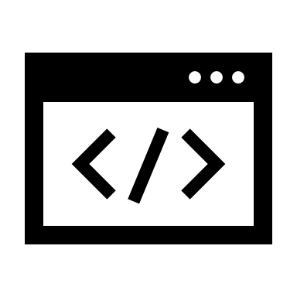

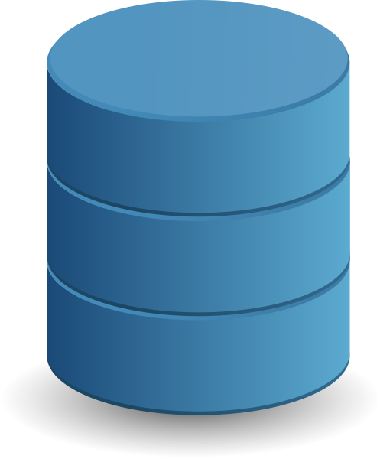


FRONTEND
HTML
CSS
JAVASCRIPT
ANGULAR
BACKEND
JAVA
ECLIPSE
SPRINGBOOT
DATABASE
MYSQL
NAVICAT
TOOLS USED
GIT
GITHUB

Slide 9

Eclipse is an Integrated Development environment (IDE) used in computer programming. It contains a base workspace and an extensible plug-in system for customizing the environment. It is the second-most-popular IDE for java development. Eclipse is written mostly in Java and its primary use is for developing Java application.

Slide 10

Spring Boot is an open source Java-based framework used to create a micro Service. It is developed by Pivotal Team and is used to build stand-alone and production ready spring applications.

Slide 11

Angular is a development platform, built on typescript. As a platform, Angular includes:
A component-based framework for building scalable web applications​
A collection of well-integrated libraries that cover a wide variety of features, including routing, forms management, client-server communication, and more​
A suite of developer tools to help you develop, build, test, and update your code​

Slide 12

JDBC
JDBC stands for Java Database Connectivity. JDBC is a Java API to connect and execute the query with the database. It is a part of JavaSE (Java Standard Edition). JDBC API uses JDBC drivers to connect with the database

Slide 13

Development
Notes:
Time – 1 min

Slide 14
PROJECT PLANNING
PLAN AND REPORT THE BASIC PROJECT ENVIRONMENT
PROJECT ANALYSIS
UNDERSTANDING THE AIM AND THE METHODOLOGY
PROJECT DESIGN
DETERMINE THE PROJECT GOALS AND ITS OUTCOMES.
Notes:
Time – 1 min

Slide 15

challenges
Notes:
Time – 2 mins

Slide 16
CHALLENGES
Technology advancement
Overtime Creating new software requires an environment that supports concentration and productivity.
System & Application Integration
TIME MANAGEMENT

Slide 17
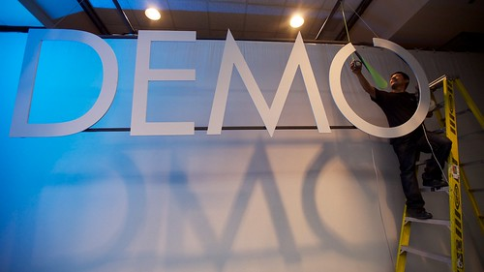
DEMONSTRATION

Slide 18
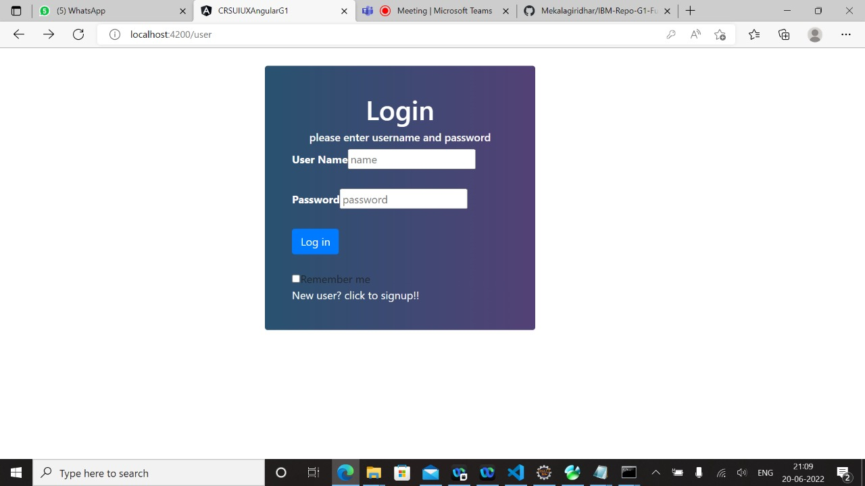
Login Page

Slide 19
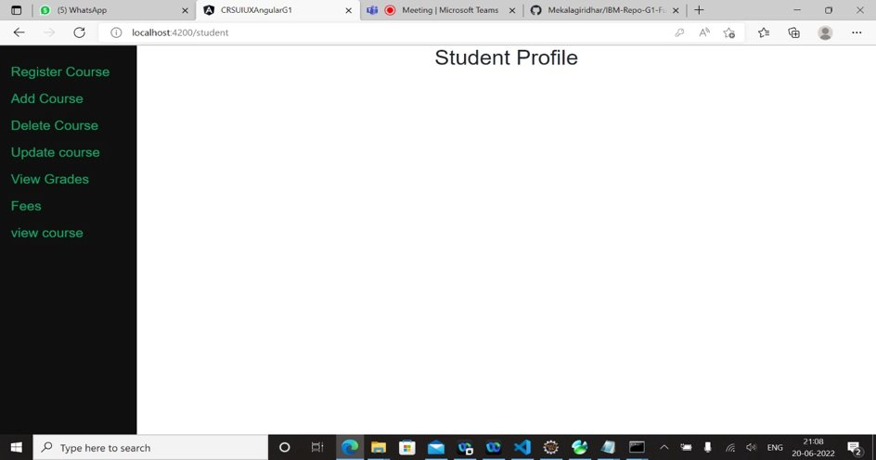
Student Profile after Logging in

Slide 20
PROJECT LINK
https://github.com/Mekalagiridhar/IBM-Repo-G1-FullStack/tree/master

Slide 21
Thank you
Notes:
Time – After this show the testimonial video. 1 min

